Slide 1
CR PRO STAFFING
Construction safety
orientation
For construction workers, millwrights, ironworkers and riggers
OSHA 10 topic-based company orientation
Company orientation only. No OSHA Outreach credit or OSHA 10 card.
CR PRO STAFFING
Notes:
Company awareness orientation. This presentation does not provide OSHA Outreach credit or an OSHA 10 card. Plan approximately 90–120 minutes plus site-specific briefings and hands-on demonstrations. Teach in a language and vocabulary workers understand. Trainer should adapt to actual hazards and applicable federal or State Plan rules.
Sources (OSHA primary sources, reviewed October 21, 2026):
https://www.osha.gov/training/outreach
https://www.osha.gov/training/outreach/faq

Slide 2
What this orientation covers
01
Recognize hazards before starting a task.
TRAINING SCOPE
02
Use the controls and PPE required for the work.
Company orientation
Separate OSHA 10, forklift and HAZWOPER training may be required
03
Report hazards, injuries and near misses promptly.
04
Confirm training and jobsite instructions before new work.
02
CR PRO STAFFING
Notes:
Explain that OSHA Outreach is a separate program conducted by an OSHA-authorized trainer or authorized online provider. An orientation does not replace training required by individual standards. Ask each worker to explain one hazard in their trade.
Sources (OSHA primary sources, reviewed October 21, 2026):
https://www.osha.gov/training/outreach
https://www.osha.gov/training/outreach/faq

Slide 3
Worker rights and shared responsibilities
01
You have a right to a safe workplace and understandable safety training.
SPEAK UP
02
Raise safety concerns and report injuries without retaliation.
Safety concerns can also go directly to OSHA
03
CR Pro Staffing and the host employer share safety responsibilities.
04
Ask both employers about an unresolved hazard or task change.
03
CR PRO STAFFING
Notes:
Discuss how to contact the site supervisor and CR Pro Staffing representative. Workers may file a confidential safety complaint with OSHA. A discrimination complaint generally must be filed within 30 days under OSH Act section 11(c). Do not require internal reporting as a prerequisite to contacting OSHA. Neither employer can contract away responsibility.
Sources (OSHA primary sources, reviewed October 21, 2026):
https://www.osha.gov/workers
https://www.osha.gov/temporaryworkers

Slide 4
Daily planning and stopping unsafe work
01
Review the task, surrounding trades and changing conditions.
DISCUSSION
02
Identify the hazard and choose controls before starting.
What changed since yesterday’s work?
03
If protection is missing, pause the task and move to safety.
04
Notify the supervisor. Resume after the hazard is controlled.
04
CR PRO STAFFING
Notes:
Suggested orientation practice: use the site's job hazard analysis or pre-task plan. Confirm the host's reporting and restart process. Do not imply an unlimited legal right to refuse all work. Walk through a specific example such as a removed guardrail or damaged sling. Safety orientation is awareness, not authorization for specialized work.
Sources (OSHA primary sources, reviewed October 21, 2026):
https://www.osha.gov/temporaryworkers
https://www.osha.gov/workers

Slide 5
The construction Focus Four
Falls
Struck-by
Edges, openings and access equipment
Vehicles, flying objects and suspended loads
Caught-in or between
Electrocution
Machinery, shifting loads and cave-ins
Power lines, circuits and damaged equipment
05
CR PRO STAFFING
Notes:
Ask workers for an example of each hazard from a recent job. Use these categories to guide the daily walk-through. Avoid presenting historical fatality statistics as current data.
Sources (OSHA primary sources, reviewed October 21, 2026):
https://www.osha.gov/sites/default/files/constrfocusfour_introduction.pdf

Slide 6
PPE for the actual hazard
01
Use properly fitting head, eye, foot and hand protection.
HANDS-ON CHECK
02
Add face, hearing, respiratory or fall protection as the task requires.
Show the PPE required for today’s task
03
Inspect PPE before use and report damage or poor fit.
04
Keep PPE clean. Replace equipment that cannot protect you.
06
CR PRO STAFFING
Notes:
Demonstrate hardhat inspection, safety glasses and footwear. A face shield supplements appropriate eye protection. Choose gloves for the task and consider entanglement hazards around rotating machinery. Employers must ensure PPE fits properly, including worker-owned PPE, and generally pay for required PPE subject to specified exceptions. Ownership does not transfer employer duties.
Sources (OSHA primary sources, reviewed October 21, 2026):
https://www.osha.gov/laws-regs/regulations/standardnumber/1926/1926.95
https://www.osha.gov/laws-regs/regulations/standardnumber/1926/1926.102
https://www.osha.gov/laws-regs/regulations/standardnumber/1926/1926.100

Slide 7

Fall hazards and protection
01
Many construction edges require fall protection at 6 feet or more.
02
Protect floor holes and openings. A loose cover is a hazard.
03
Use the assigned guardrails, restraint or fall arrest system.
04
Different rules apply to scaffolds and steel erection.
HAZARD EXAMPLE: unprotected edges and openings
Confirm the task’s rule and the site’s fall protection plan
07
CR PRO STAFFING
Notes:
1926.501(b)(1) generally covers unprotected sides and edges 6 feet or more above a lower level. Hole requirements vary by hazard and covers are needed for trip/step-through hazards. Scaffolds generally require fall protection above 10 feet. Steel erection generally requires it above 15 feet with special provisions for connectors and controlled decking zones. Never apply one threshold to all work. Site rules may be more protective.
Sources (OSHA primary sources, reviewed October 21, 2026):
https://www.osha.gov/laws-regs/regulations/standardnumber/1926/1926.501
https://www.osha.gov/laws-regs/regulations/standardnumber/1926/1926.451
https://www.osha.gov/laws-regs/regulations/standardnumber/1926/1926.760
Photo: OSHA
https://www.osha.gov/etools/construction/falls
https://www.osha.gov/sites/default/files/inline-images/unprotected_sides.jpg
Illustrative real-world image. It does not establish full compliance or endorsement of CR Pro Staffing.

Slide 8
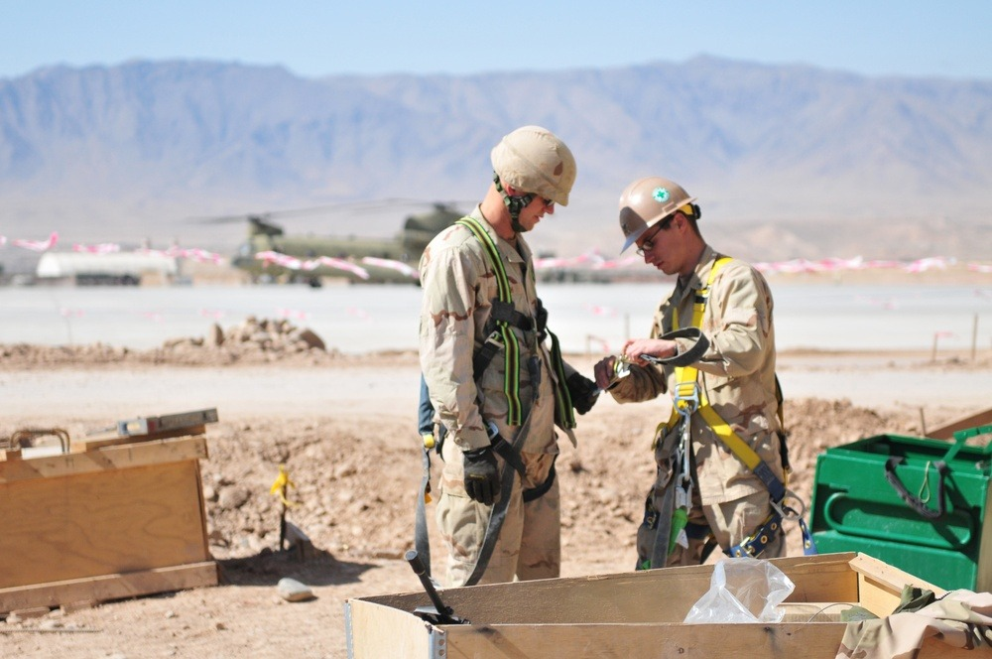
Harnesses and double self-retracting lifelines
01
Check the harness, connectors, labels and lifelines before use.
02
Use a site-approved anchorage and compatible equipment.
03
Follow the manufacturer’s rules for transfers and attachment.
04
Confirm fall clearance, swing-fall exposure and rescue arrangements.
Construction crew preparing safety harnesses
A harness alone does not prevent a fall
08
CR PRO STAFFING
Notes:
Demonstrate fit and the actual double self-retracting lifeline, often called double yoyos. Maintain continuous attachment when the approved system and task require it. Do not invent attachment points or connect hooks to each other. Use only devices rated for the edge exposure and anchorage position. Remove damaged equipment and equipment subjected to fall forces from service pending proper evaluation. Employer must provide prompt rescue or ensure self-rescue. This slide does not qualify users.
Sources (OSHA primary sources, reviewed October 21, 2026):
https://www.osha.gov/laws-regs/regulations/standardnumber/1926/1926.502
Photo: U.S. Navy / DVIDS
https://www.dvidshub.net/news/66391/seabees-build-up-southern-afghanistan
https://d1ldvf68ux039x.cloudfront.net/thumbs/photos/1103/373011/1000w_q95.jpg
Illustrative real-world image. It does not establish full compliance or endorsement of CR Pro Staffing.

Slide 9
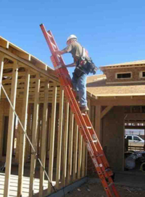
Portable ladder safety
01
Inspect the ladder and remove defective ladders from use.
02
Set non-self-supporting ladders at about a 4-to-1 angle.
03
For landing access, rails generally extend at least 3 feet above it.
04
Face the ladder, keep a hand on it and avoid overreaching.
Field example: ladder access
4 up
1 out
09
CR PRO STAFFING
Notes:
Use stable, level footing or secure the ladder against displacement. Protect ladders in traffic areas. Do not stand on the top or top step of a stepladder. If 3-foot rail extension is impossible, follow the standard's securing and grasping-device provisions. Choose nonconductive side rails near exposed energized equipment. Diagram is schematic, not to scale.
Sources (OSHA primary sources, reviewed October 21, 2026):
https://www.osha.gov/laws-regs/regulations/standardnumber/1926/1926.1053
Photo: OSHA
https://www.osha.gov/etools/construction/falls
https://www.osha.gov/sites/default/files/inline-images/ladder-safe-manner_sm.jpg
Illustrative real-world image. It does not establish full compliance or endorsement of CR Pro Staffing.

Slide 10
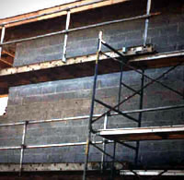
Scaffolds and elevating work platforms
01
Use scaffolds only after required inspection and training.
02
Use designated access. Keep platforms and guardrails intact.
03
Operate lifts only with training and employer authorization.
04
Check controls, ground conditions, overhead hazards and capacity.
HAZARD EXAMPLE: incomplete scaffold guardrails
Use the fall protection specified for that lift
10
CR PRO STAFFING
Notes:
A competent person inspects scaffolds before each shift and after events that could affect structural integrity. Do not climb cross braces. Scaffold fall protection is generally required above 10 feet and the correct system depends on scaffold type. Boom lifts and scissor lifts have different requirements. Follow applicable standards, the manufacturer's instructions and site plan. Stand on the platform floor, not rails. A generic lift card alone does not establish task/equipment competence.
Sources (OSHA primary sources, reviewed October 21, 2026):
https://www.osha.gov/laws-regs/regulations/standardnumber/1926/1926.451
https://www.osha.gov/laws-regs/regulations/standardnumber/1926/1926.453
Photo: OSHA
https://www.osha.gov/etools/construction/falls
https://www.osha.gov/sites/default/files/inline-images/improper_scaffolds.jpg
Illustrative real-world image. It does not establish full compliance or endorsement of CR Pro Staffing.

Slide 11
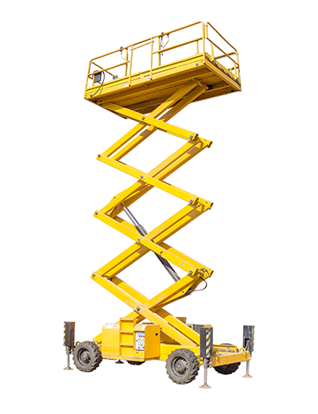
Boom lifts and scissor lifts
01
Boom lift: use the specified restraint or fall arrest system at the approved anchor.
02
Scissor lift: keep complete guardrails and gates in place.
03
Keep feet on the platform floor. Never add a ladder for reach.
04
Follow limits for wind, slope, travel and platform load.
Equipment example: scissor lift
Check overhead clearance and the ground before every move
11
CR PRO STAFFING
Notes:
Only trained, authorized workers operate lifts. Show emergency lowering controls and explain the ground rescue plan. For boom lifts, never tie off to adjacent structures while working from the basket. Scissor lift guardrails generally provide required fall protection when adequate. Additional equipment may be required by the manufacturer or site. Never improvise an anchor.
Sources (OSHA primary sources, reviewed October 21, 2026):
https://www.osha.gov/laws-regs/regulations/standardnumber/1926/1926.453
https://www.osha.gov/etools/scaffolding/scissor-lifts
Photo: OSHA
https://www.osha.gov/etools/scaffolding/scissor-lifts
https://www.osha.gov/sites/default/files/inline-images/scissorlifts.png
Illustrative real-world image. It does not establish full compliance or endorsement of CR Pro Staffing.

Slide 12
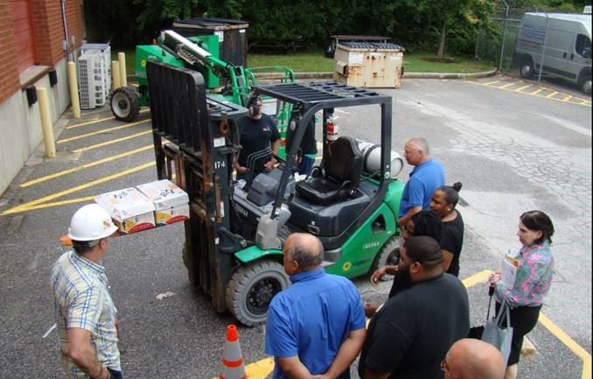
Forklift operator training and certification
01
Training includes instruction, practical exercises and a workplace evaluation.
02
The employer documents successful training and evaluation.
03
Evaluate each operator at least every 3 years.
04
Unsafe operation or changed conditions can trigger refresher training.
MOSH forklift training event
This orientation does not certify a forklift operator
12
CR PRO STAFFING
Notes:
Construction operator training follows 1910.178(l) through 1926.602(d). Documentation includes operator name, training/evaluation dates and trainer/evaluator identity. Qualified trainers need relevant knowledge, training and experience. Prior training can count only when appropriate and competence has been evaluated. Employer authorization must match the truck and workplace.
Sources (OSHA primary sources, reviewed October 21, 2026):
https://www.osha.gov/laws-regs/regulations/standardnumber/1910/1910.178
https://www.osha.gov/laws-regs/regulations/standardnumber/1926/1926.602
Photo: OSHA
https://www.osha.gov/successstories/safeandsound
https://www.osha.gov/sites/default/files/inline-images/ss-safeandsound.jpg
Illustrative real-world image. It does not establish full compliance or endorsement of CR Pro Staffing.

Slide 13
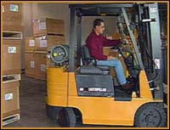
Forklift and telehandler hazards
01
Inspect before service. Remove unsafe trucks from use.
02
Check the capacity plate and approved attachment.
03
Keep loads low during travel and keep pedestrians clear.
04
Use the operator restraint and follow equipment-specific instructions.
Equipment example: powered industrial truck
Reach, load center and attachments affect capacity
13
CR PRO STAFFING
Notes:
Do not stand or walk under raised forks. No unauthorized riders. Park with forks lowered and secure the truck. Telehandler operators must use the applicable load chart. Equipment type, configuration and use determine applicable rules. Follow manufacturer instructions for slopes, visibility and tip-over response.
Sources (OSHA primary sources, reviewed October 21, 2026):
https://www.osha.gov/laws-regs/regulations/standardnumber/1910/1910.178
https://www.osha.gov/laws-regs/regulations/standardnumber/1926/1926.602
Photo: OSHA
https://www.osha.gov/etools/powered-industrial-trucks
https://www.osha.gov/sites/default/files/inline-images/pitetool_02%20%281%29.jpg
Illustrative real-world image. It does not establish full compliance or endorsement of CR Pro Staffing.

Slide 14
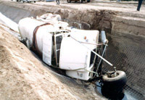
Struck-by hazards and moving equipment
01
Stay outside barricades, swing areas and equipment travel paths.
02
Make clear contact with the operator before approaching.
03
Follow the spotter’s directions and keep an escape path.
04
Secure tools and materials that could fall or become airborne.
HAZARD EXAMPLE: vehicle at an excavation
Keep your body out of the travel path
14
CR PRO STAFFING
Notes:
Discuss backing vehicles, crane counterweights, grinding fragments and materials falling from elevated work. Eye contact alone may be insufficient in poor visibility. Use the site's agreed signal or radio procedure and wait for acknowledgment. Stop if communication is lost. Wear required high-visibility clothing.
Sources (OSHA primary sources, reviewed October 21, 2026):
https://www.osha.gov/etools/construction/struck-by
Photo: OSHA
https://www.osha.gov/etools/construction/struck-by
https://www.osha.gov/sites/default/files/inline-images/vehicles.jpg
Illustrative real-world image. It does not establish full compliance or endorsement of CR Pro Staffing.

Slide 15
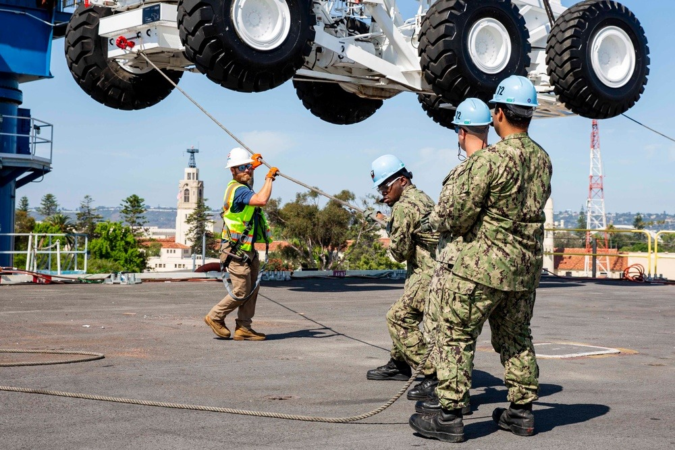
Rigging and suspended loads
01
Only assigned, properly trained personnel rig or signal lifts.
02
Inspect slings and hardware each shift and during use as needed.
03
Confirm load weight, ratings, hitch and sling angle before lifting.
04
Stay clear of suspended loads, pinch points and the fall zone.
HAZARD DISCUSSION: identify load-zone exposure
Damaged sling or unreadable rating?
Remove it from service
15
CR PRO STAFFING
Notes:
A qualified rigger is required for specified crane operations, including rigging within the fall zone. Signal persons must meet applicable qualification rules. Never guess a load weight or exceed the rated load for the hitch/angle. Protect slings from sharp edges. Follow the planned hoisting route and use tag lines only when appropriate and safe. Discuss hand placement while landing a load. This orientation does not qualify a rigger or signal person.
Sources (OSHA primary sources, reviewed October 21, 2026):
https://www.osha.gov/laws-regs/regulations/standardnumber/1926/1926.251
https://www.osha.gov/laws-regs/regulations/standardnumber/1926/1926.1425
Photo: U.S. Navy / DVIDS
https://www.dvidshub.net/image/7948536/sailors-onload-aircraft-crash-and-salvage-crane-onto-flight-deck-abraham-lincoln
https://d1ldvf68ux039x.cloudfront.net/thumbs/photos/2308/7948536/1000w_q95.jpg
Illustrative real-world image. It does not establish full compliance or endorsement of CR Pro Staffing.

Slide 16
Caught-in and caught-between hazards
01
Keep hands clear of rotating shafts, belts and pinch points.
MILLWRIGHT EXAMPLE
02
Keep guards in place while equipment operates.
An emergency stop does not isolate all energy
03
Stay out from between moving equipment and fixed objects.
04
Support loads against movement before reaching underneath.
16
CR PRO STAFFING
Notes:
Explain pinch points during alignment, conveyor work and machinery setting. Loose clothing, jewelry, hair and some gloves can catch rotating parts. Never reach into moving machinery. Isolate hazardous energy before servicing, adjusting or clearing a jam under the equipment-specific procedure.
Sources (OSHA primary sources, reviewed October 21, 2026):
https://www.osha.gov/laws-regs/regulations/standardnumber/1926/1926.300
https://www.osha.gov/laws-regs/regulations/standardnumber/1910/1910.147

Slide 17

Electrical hazards
01
Treat unknown circuits and overhead lines as energized.
02
Only qualified and authorized personnel perform electrical work.
03
Remove damaged cords, plugs and tools from service.
04
Use the site’s required GFCI or assured grounding program.
Hazard recognition: overhead power lines
A GFCI cannot make contact with a power line safe
17
CR PRO STAFFING
Notes:
For construction, 1926.404(b)(1) specifies GFCI or an assured equipment grounding conductor program for covered receptacles and equipment. Follow the site's established program. Keep cords away from water and damage. Keep required clearances from power lines, which depend on equipment, voltage and task. Do not teach one universal approach distance. Qualified personnel establish deenergization, guarding and verification.
Sources (OSHA primary sources, reviewed October 21, 2026):
https://www.osha.gov/laws-regs/regulations/standardnumber/1926/1926.416
https://www.osha.gov/laws-regs/regulations/standardnumber/1926/1926.404
Photo: OSHA
https://www.osha.gov/etools/construction/electrical-incidents
https://www.osha.gov/sites/default/files/inline-images/powerlines.jpg
Illustrative real-world image. It does not establish full compliance or endorsement of CR Pro Staffing.

Slide 18
Hazardous energy and lockout/tagout
01
Identify electrical, hydraulic, pneumatic and stored mechanical energy.
BEFORE SERVICING
02
Only authorized workers carry out the isolation procedure.
A stop button can leave hazardous energy present
03
Isolate, secure, release stored energy and verify a safe state.
04
Never remove another worker’s lock or restart without authorization.
18
CR PRO STAFFING
Notes:
Use the host's equipment-specific energy-control procedure and group/shift-transfer process. Some millwright maintenance falls under general industry 1910.147, which excludes construction employment. Construction electrical circuit lockout/tagging is addressed in 1926.417, with other task-specific provisions also applicable. The employer must determine the correct standard. This slide describes awareness and does not authorize lockout work. Exceptional lock removal requires the employer's controlled procedure.
Sources (OSHA primary sources, reviewed October 21, 2026):
https://www.osha.gov/laws-regs/regulations/standardnumber/1926/1926.417
https://www.osha.gov/laws-regs/regulations/standardnumber/1910/1910.147

Slide 19
Trenches and excavations
01
Enter only after a competent person checks the excavation.
NO IMPROVISED RESCUE
02
At 5 feet or deeper, cave-in protection is generally required.
An unprotected trench can collapse without warning
03
Use required safe access. Keep spoil and equipment back.
04
Leave immediately if water, cracks or other hazards appear.
19
CR PRO STAFFING
Notes:
Cave-in protection is required except in stable rock or excavations under 5 feet where a competent person finds no indication of potential cave-in. At 4 feet or deeper, trench egress must be within 25 feet of lateral travel. Keep spoil/equipment at least 2 feet from the edge or use retaining devices. Inspections occur daily before work and as needed, including after rain. Evaluate utilities and atmospheres. Summon trained rescuers. Never enter a collapsed trench to help.
Sources (OSHA primary sources, reviewed October 21, 2026):
https://www.osha.gov/laws-regs/regulations/standardnumber/1926/1926.652
https://www.osha.gov/laws-regs/regulations/standardnumber/1926/1926.651

Slide 20
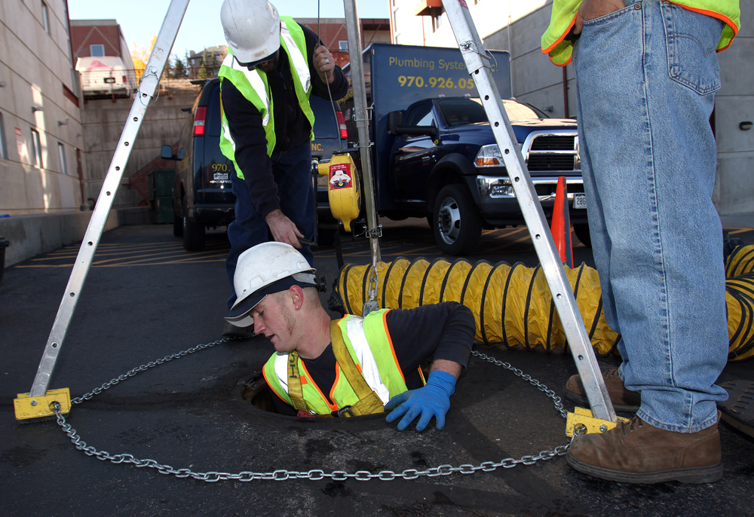
Confined spaces
01
Tanks, pits and similar spaces may contain hidden lethal hazards.
02
Check the site’s space identification and entry restrictions.
03
Enter permit spaces only under the approved program and training.
04
If someone collapses inside, summon the designated rescue service.
Confined-space entry equipment in use
Never enter a space to attempt an unplanned rescue
20
CR PRO STAFFING
Notes:
A competent person must identify confined and permit spaces before work. An open lid or normal smell does not demonstrate safe air. A permit entry may require atmospheric testing, ventilation, isolation, attendants, communications and rescue capability. The host/controlling contractor and entry employers must coordinate hazard information. This orientation authorizes no confined-space entry.
Sources (OSHA primary sources, reviewed October 21, 2026):
https://www.osha.gov/laws-regs/regulations/standardnumber/1926/1926.1203
Photo: Dig Different / Plumbing Systems Inc.
https://www.digdifferent.com/online_exclusives/2014/08/10_photos_of_proper_confined-space_entry_work
https://cdn.digdifferent.com/uploads/images/psi_confined_space_2_dt_10-22-12-web.jpg?v=1768515384
Illustrative real-world image. It does not establish full compliance or endorsement of CR Pro Staffing.

Slide 21
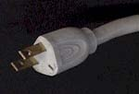
Hand tools, grinders and power tools
01
Choose the correct tool, accessory and operating speed.
02
Keep guards in place and inspect before use.
03
Secure the work and keep others clear of chips and sparks.
04
Disconnect or isolate energy before changing accessories.
HAZARD EXAMPLE: missing grounding pin
A damaged wheel or missing guard ends the task
21
CR PRO STAFFING
Notes:
Demonstrate actual tool inspection. Check abrasive wheel condition, guard placement and compatible wheel ratings. Use eye protection and the required face shield. Follow manufacturer instructions and the task-specific energy isolation method. Never defeat a safety device. Report defective tools and remove them from use.
Sources (OSHA primary sources, reviewed October 21, 2026):
https://www.osha.gov/laws-regs/regulations/standardnumber/1926/1926.300
Photo: OSHA
https://www.osha.gov/etools/construction/electrical-incidents
https://www.osha.gov/sites/default/files/inline-images/missingpin.jpg
Illustrative real-world image. It does not establish full compliance or endorsement of CR Pro Staffing.

Slide 22
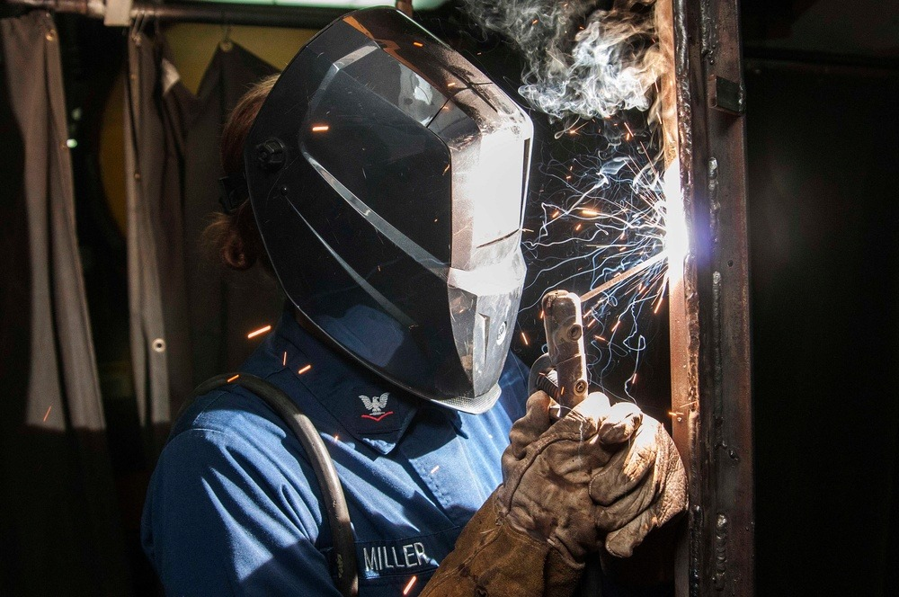
Hot work and fire prevention
01
Confirm the site’s hot-work permit and fire-watch requirements.
02
Remove or shield combustibles, including on the opposite side.
03
Control welding fumes and protect others from arc radiation.
04
Keep suitable fire equipment ready and maintain an exit route.
Welding helmet and protective gloves in use
Fire watch continues for the required monitoring period
22
CR PRO STAFFING
Notes:
Federal construction hot-work rules require a fire watch when normal precautions are insufficient and continued monitoring long enough to eliminate fire possibility. The site permit may specify a longer period. Do not invent a universal 30-minute limit. Follow separate cylinder, welding ventilation and PPE requirements. Use an extinguisher only if trained, authorized and it is safe. Otherwise alert and evacuate.
Sources (OSHA primary sources, reviewed October 21, 2026):
https://www.osha.gov/laws-regs/regulations/standardnumber/1926/1926.352
Photo: U.S. Navy / Jermaine M. Ralliford
https://www.dvidshub.net/image/1428858/uss-dwight-d-eisenhower-sailor-practices-vertical-welding
https://d1ldvf68ux039x.cloudfront.net/thumbs/photos/1407/1428858/1000w_q95.jpg
Illustrative real-world image. It does not establish full compliance or endorsement of CR Pro Staffing.

Slide 23
Chemical labels and safety data sheets
01
Read the container label before using a chemical.
SHOW THE LOCATION
02
Find the safety data sheet and review hazards and precautions.
Every worker needs access to the SDS
03
Use the specified ventilation, handling methods and PPE.
04
Report unlabeled containers and spills. Avoid unknown products.
23
CR PRO STAFFING
Notes:
Demonstrate the site's SDS access method, including access during the shift without barriers. Explain signal words, pictograms and precautionary statements. SDS sections 2, 4, 7 and 8 address hazards, first aid, handling/storage and exposure controls/PPE. Secondary containers need appropriate labeling except for qualifying immediate-use situations. Spill response requires training and appropriate protection.
Sources (OSHA primary sources, reviewed October 21, 2026):
https://www.osha.gov/hazcom

Slide 24
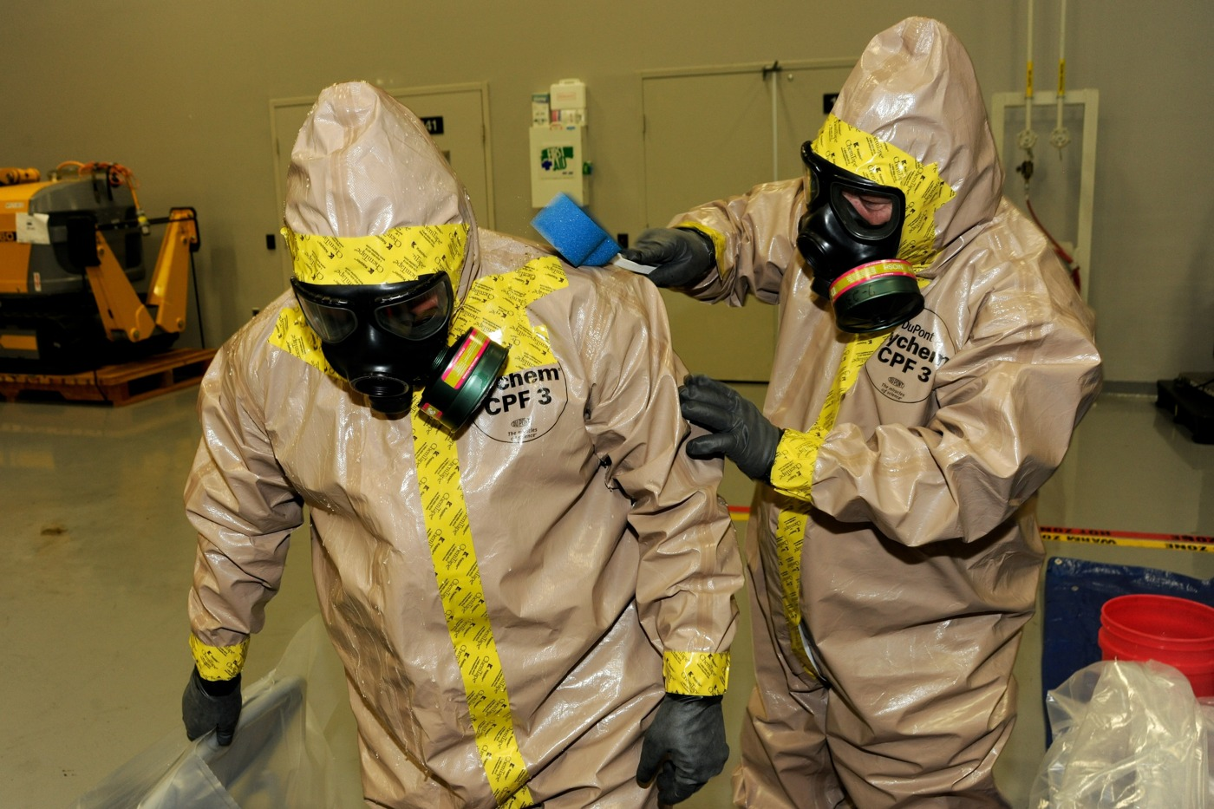
Hazardous materials and unknown spills
01
Treat unknown substances and damaged containers as hazards.
02
Keep clear and alert the site’s designated response contact.
03
Never touch, smell closely, mix or clean up an unknown spill.
04
Use chemical-resistant equipment selected for the specific substance.
Chemical protective clothing during training
Keep others away from a safe location and follow evacuation instructions
24
CR PRO STAFFING
Notes:
This is hazard awareness. Only trained, equipped and authorized personnel handle a spill within their assigned role. Hazard Communication applies to many routine chemical uses. HAZWOPER applies to specified waste operations and emergency responses. Do not assume every chemical spill requires the same course. Use the SDS and site response plan.
Sources (OSHA primary sources, reviewed October 21, 2026):
https://www.osha.gov/hazcom
https://www.osha.gov/laws-regs/regulations/standardnumber/1926/1926.65
Photo: U.S. Army
https://www.army.mil/article/116376/ecbc_partners_with_jpm_elimination_for_personnel_decontamination_training
https://api.army.mil/e2/c/images/2013/12/04/323325/original.jpg
Illustrative real-world image. It does not establish full compliance or endorsement of CR Pro Staffing.

Slide 25
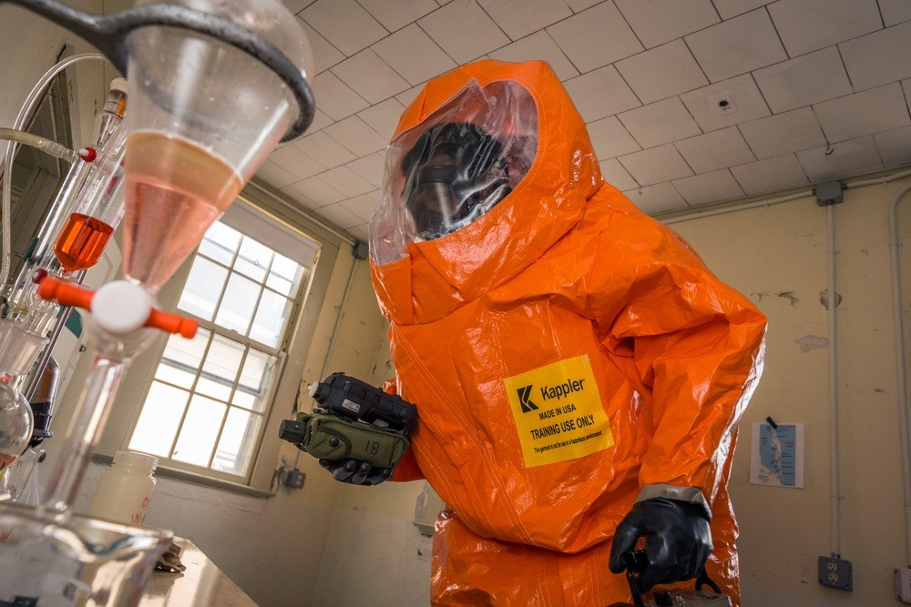
HAZWOPER awareness and training limits
01
HAZWOPER covers specified hazardous waste operations and emergency response.
02
General cleanup-site workers typically need 40 hours plus 3 field days.
03
Certain limited cleanup roles qualify for 24 hours plus 1 field day.
04
Cleanup workers covered by these provisions need annual 8-hour refreshers.
Hazardous materials training exercise
This deck provides no HAZWOPER qualification
25
CR PRO STAFFING
Notes:
Under 1926.65(e), limited-role eligibility depends on exposure and site conditions. Emergency response under (q) uses separate competency levels. Awareness responders recognize and notify, with no further response action. This orientation alone does not establish that competency. Confirm the role, site plan and training before assignment.
Sources (OSHA primary sources, reviewed October 21, 2026):
https://www.osha.gov/laws-regs/regulations/standardnumber/1926/1926.65
Photo: U.S. National Guard / DVIDS
https://www.dvidshub.net/image/3796968/cst-pre-eval-sandy-hook
https://d1ldvf68ux039x.cloudfront.net/thumbs/photos/1709/3796968/1000w_q95.jpg
Illustrative real-world image. It does not establish full compliance or endorsement of CR Pro Staffing.

Slide 26
Silica, dust and respiratory protection
01
Cutting or drilling concrete can create respirable silica dust.
RESPIRATOR CHECK
02
Use the assigned water delivery or dust collection controls.
A face covering cannot replace required respiratory protection
03
Follow the exposure-control plan and approved cleanup method.
04
Required respirator use needs the employer’s protection program.
26
CR PRO STAFFING
Notes:
Use Table 1 or the alternative exposure-control methods in 1926.1153 as applicable. Avoid dry sweeping or brushing when it could contribute to exposure unless wet sweeping, HEPA vacuuming or other minimizing methods are infeasible. Compressed-air cleaning has restrictions. Required respirators need medical evaluation and training, and tight-fitting respirators need fit testing and user seal checks. Facial hair cannot interfere with the seal.
Sources (OSHA primary sources, reviewed October 21, 2026):
https://www.osha.gov/laws-regs/regulations/standardnumber/1926/1926.1153
https://www.osha.gov/laws-regs/regulations/standardnumber/1910/1910.134

Slide 27
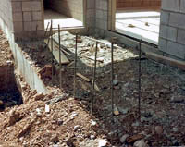
Noise, lifting and housekeeping
01
Use required hearing protection and confirm proper fit.
02
Plan material moves. Use lifting aids or help when needed.
03
Keep walkways, stairs and exits clear.
04
Control sharp scrap, protruding nails and slippery surfaces.
HAZARD EXAMPLE: exposed reinforcing steel
A clear route makes every material move safer
27
CR PRO STAFFING
Notes:
Discuss noise controls before PPE and the site's hearing conservation practices. There is no universal OSHA safe lifting weight. Consider load shape, reach, repetition and worker capability. Keep material stacked against collapse. For industrial tasks, verify the applicable standard and site procedures.
Sources (OSHA primary sources, reviewed October 21, 2026):
https://www.osha.gov/laws-regs/regulations/standardnumber/1926/1926.52
https://www.osha.gov/laws-regs/regulations/standardnumber/1926/1926.25
https://www.osha.gov/laws-regs/regulations/standardnumber/1926/1926.250
Photo: OSHA
https://www.osha.gov/etools/construction/falls
https://www.osha.gov/sites/default/files/inline-images/rebards.jpg
Illustrative real-world image. It does not establish full compliance or endorsement of CR Pro Staffing.

Slide 28
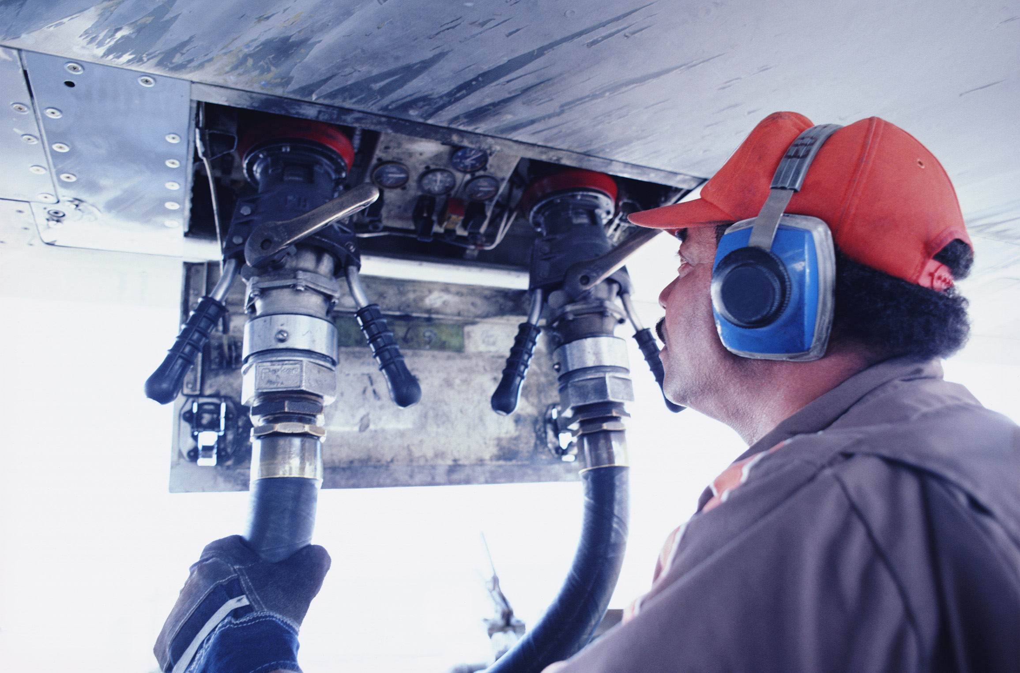
Noise exposure limits and hearing protection
01
Federal construction examples: 90 dBA for 8 hours or 95 dBA for 4 hours.
02
At 100 dBA, the table allows only 2 hours per day.
03
Mixed noise exposures add together across the shift.
04
Reduce noise at the source and use required hearing protection.
Hearing protection in an industrial work area
These limits do not guarantee that hearing damage cannot occur
28
CR PRO STAFFING
Notes:
1926.52 Table D-2 uses dBA slow response. Limits refer to exposure before protector attenuation. Feasible engineering/administrative controls come first. A continuing effective hearing conservation program is required where table values are exceeded. Use measured exposure and qualified assessment, not a phone app or guess. The employer should use a more protective applicable limit or site rule. General industry and State Plan requirements may differ.
Sources (OSHA primary sources, reviewed October 21, 2026):
https://www.osha.gov/laws-regs/regulations/standardnumber/1926/1926.52
Photo: OSHA
https://www.osha.gov/noise
https://www.osha.gov/sites/default/files/inline-images/image%201_0.jpg
Illustrative real-world image. It does not establish full compliance or endorsement of CR Pro Staffing.

Slide 29
Heat illness prevention
01
Drink water regularly and take the planned cooling breaks.
FLORIDA AND HOT JOBSITES
02
Build heat tolerance gradually after starting or returning to work.
Indoor heat and heavy PPE can also cause illness
03
Watch coworkers for dizziness, weakness or unusual behavior.
04
Report symptoms early and move to a cooler area with help.
29
CR PRO STAFFING
Notes:
Follow the employer's heat plan, including acclimatization, workload adjustments, water and cool rest areas. This slide gives preventive guidance, not a universal regulatory temperature or break trigger. Weather, workload, clothing and worker factors all matter. Do not leave a symptomatic coworker alone. Ask workers to name the nearest cooling area.
Sources (OSHA primary sources, reviewed October 21, 2026):
https://www.osha.gov/heat-exposure
https://www.osha.gov/heat-exposure/illness-first-aid

Slide 30
Heat emergency response
01
Confusion, slurred speech, seizure or collapse is an emergency.
ACT IMMEDIATELY
02
Call 911 and activate the site emergency response.
Heat stroke can occur even when a worker is sweating
03
Begin rapid cooling while help is coming.
04
Stay with the worker. Never give fluids to someone unable to drink safely.
30
CR PRO STAFFING
Notes:
Move the worker to shade or a cool location if safe. Remove excess outer clothing and use available active cooling such as cold-water immersion or wetting skin and clothing with cold water while fanning. Follow dispatcher and trained-responder directions. Do not delay cooling to make a diagnosis. Do not force fluids on an unconscious, confused or vomiting worker.
Sources (OSHA primary sources, reviewed October 21, 2026):
https://www.osha.gov/heat-exposure/illness-first-aid

Slide 31
Emergency action and incident reporting
01
Know the alarm, evacuation route and assembly point.
ACCOUNTABILITY
02
For a serious emergency, call 911 and notify site response.
Check in at the assembly point and wait for instructions
03
Give the exact address, access gate and nature of the emergency.
04
Report injuries, near misses and unsafe conditions promptly.
31
CR PRO STAFFING
Notes:
Explain who contacts responders, who meets the ambulance and how headcounts work. CR Pro Staffing reporting does not replace emergency response. Workers should notify the site supervisor and CR Pro Staffing contact. Only trained personnel provide care within their training. Never enter an electrical, trench or confined-space hazard to rescue someone. Keep access clear.
Sources (OSHA primary sources, reviewed October 21, 2026):
https://www.osha.gov/laws-regs/regulations/standardnumber/1926/1926.50
https://www.osha.gov/temporaryworkers

Slide 32
Jobsite briefing before assignment
01
Project / work area: ______________________________
COMPLETE ON SITE
02
Site supervisor / phone: __________________________
No assignment begins until the worker understands the site plan
03
CR Pro contact / phone: __________________________
04
Emergency address / gate: ________________________
05
Alarm / assembly point: __________________________
06
First aid / AED / SDS / cooling area: _________________
32
CR PRO STAFFING
Notes:
Trainer: complete these fields before using this slide on a jobsite. Confirm host orientation, required task training, competent persons, PPE, rescue provisions and authorization for the assigned work. These are intentional blanks for jobsite customization. Show workers the locations rather than only reading them.
Sources (OSHA primary sources, reviewed October 21, 2026):
https://www.osha.gov/temporaryworkers
https://www.osha.gov/laws-regs/regulations/standardnumber/1926/1926.50

Slide 33
Trade scenarios
01
Millwright
A conveyor is stopped, but no one verified isolation.
CREW DISCUSSION
02
Ironworker
Next connection is outside the protected area.
What is the hazard?
What must happen before work continues?
03
Rigger
A sling’s identification tag is unreadable.
04
All trades
A coworker in the heat becomes confused.
33
CR PRO STAFFING
Notes:
Expected responses: conveyor: keep clear until an authorized worker follows the equipment energy-control procedure and verifies isolation. Ironworker: pause and confirm the approved fall protection and transfer method, without improvising anchors. Rigger: remove the sling from service and obtain correctly rated gear. Heat: call 911, activate response and cool immediately. Discuss without asking workers to perform untrained tasks.
Sources (OSHA primary sources, reviewed October 21, 2026):
https://www.osha.gov/laws-regs/regulations/standardnumber/1926/1926.251
https://www.osha.gov/laws-regs/regulations/standardnumber/1926/1926.502
https://www.osha.gov/laws-regs/regulations/standardnumber/1910/1910.147
https://www.osha.gov/heat-exposure/illness-first-aid

Slide 34
Knowledge check 1
01
A grinder guard is missing. What do you do?
ASK THE CREW
02
Can this company orientation issue an OSHA 10 card?
Explain the safe action in your own words
03
Who needs to know about an unresolved jobsite hazard?
04
Is a stop button enough to make conveyor servicing safe?
34
CR PRO STAFFING
Notes:
Answers: 1. Stop using it, remove it from service and report it. 2. No. OSHA Outreach course completion requires the authorized program. 3. Notify the host supervisor and CR Pro Staffing representative. Workers may also contact OSHA. 4. No. The authorized equipment-specific isolation process and verification are required. Re-teach missed answers. This is an orientation review, not an OSHA examination.
Sources (OSHA primary sources, reviewed October 21, 2026):
https://www.osha.gov/laws-regs/regulations/standardnumber/1926/1926.300
https://www.osha.gov/training/outreach
https://www.osha.gov/temporaryworkers
https://www.osha.gov/laws-regs/regulations/standardnumber/1910/1910.147

Slide 35
Knowledge check 2
05
What do you do with a damaged or unidentified sling?
DISCUSS AND DEMONSTRATE
06
Can you enter a confined space to rescue a coworker?
Correct missed answers before the assignment
07
A worker becomes confused in the heat. What happens next?
08
What must you confirm before using a fall arrest system?
35
CR PRO STAFFING
Notes:
Answers: 5. Remove it from service and use inspected, properly rated gear. 6. Never attempt an unplanned entry rescue. Summon the designated trained rescue service. 7. Call 911, activate site response and begin rapid cooling. 8. Training, inspected compatible equipment, approved anchor, clearance/swing-fall control and prompt rescue plan. Ask workers to identify their reporting contacts and assembly point.
Sources (OSHA primary sources, reviewed October 21, 2026):
https://www.osha.gov/laws-regs/regulations/standardnumber/1926/1926.251
https://www.osha.gov/laws-regs/regulations/standardnumber/1926/1926.1203
https://www.osha.gov/heat-exposure/illness-first-aid
https://www.osha.gov/laws-regs/regulations/standardnumber/1926/1926.502

Slide 36
Knowledge check 3
09
Does a presentation alone qualify you to operate a forklift?
REVIEW THE LIMITS
10
Can any worker clean up an unknown chemical spill?
Training must match the task, equipment and workplace
11
Is a 90 dBA reading safe for an unlimited shift?
12
Can you stand on lift rails to reach the work?
36
CR PRO STAFFING
Notes:
Answers: 9. No. Instruction, practical training and workplace evaluation are needed. 10. No. Keep clear, alert designated responders and follow the plan. 11. No. Duration and the combined daily exposure matter. 12. No. Keep feet on the platform and use equipment appropriate for the reach. Re-teach missed items.
Sources (OSHA primary sources, reviewed October 21, 2026):
https://www.osha.gov/laws-regs/regulations/standardnumber/1910/1910.178
https://www.osha.gov/laws-regs/regulations/standardnumber/1926/1926.65
https://www.osha.gov/laws-regs/regulations/standardnumber/1926/1926.52
https://www.osha.gov/laws-regs/regulations/standardnumber/1926/1926.453

Slide 37
Orientation acknowledgment
01
Worker name / ID: _______________________________
TRAINING RECORD
02
Jobsite / assignment: ____________________________
Record the site briefing and any required follow-up training
03
Trainer / date / language: ________________________
04
Worker signature: ______________________________
05
Trainer signature: ______________________________
06
Questions / training still needed: __________________
37
CR PRO STAFFING
Notes:
Suggested record wording: I attended this company orientation, had the opportunity to ask questions and know how to report a safety concern. Signature documents attendance only. It is not a waiver of rights, OSHA Outreach credit or proof of equipment/task competence. Retain the attendance record, topics, language, instructor, knowledge review and hands-on training details according to company requirements. Resolve outstanding training before assigning affected work.
Sources (OSHA primary sources, reviewed October 21, 2026):
https://www.osha.gov/training/outreach/faq
https://www.osha.gov/temporaryworkers

Slide 38
Instructor preparation and references
01
Review current federal or State Plan rules and the host’s procedures.
BEFORE DELIVERY
02
Complete the jobsite slide and confirm emergency and reporting contacts.
Company orientation
Adapt to the assigned job and worker’s language
03
Use actual PPE and equipment for demonstrations by qualified trainers.
04
Source links and teaching prompts appear in each slide’s speaker notes.
38
CR PRO STAFFING
Notes:
Prepared October 21, 2026 from OSHA primary sources. Confirm requirements at delivery. Add company-approved policies and actual emergency contacts. Do not display an OSHA logo, call this OSHA-approved, issue a certification, or represent this as the required 10-hour Outreach course. Main resources: https://www.osha.gov/training/outreach ; https://www.osha.gov/workers ; https://www.osha.gov/temporaryworkers ; https://www.osha.gov/laws-regs/regulations/standardnumber/1926 . Federal rules are a baseline and State Plans and host procedures may differ.
Sources (OSHA primary sources, reviewed October 21, 2026):
https://www.osha.gov/training/outreach
https://www.osha.gov/workers
https://www.osha.gov/temporaryworkers
https://www.osha.gov/laws-regs/regulations/standardnumber/1926

